Slide 1
Analysis of Algorithm Efficiency
Chapter 2
Dr. Maram Bani Younes

Slide 2
Contents
Analysis of Algorithms
Order of Growth
Best Case, Average Case, Worst Case
Calculating The Running Time of a program
Analysing the Time Efficiency of Non-recursive Algorithms
Analysing the Time Efficiency of Recursive Algorithms
Empirical analysis of time efficiency

Slide 3
Analysis of algorithms
Dimensions:
Generality
Simplicity
Time efficiency
Space efficiency
The term “analysis of algorithms” is usually used in a narrower, technical sense to mean an investigation of an algorithm’s efficiency with respect to two resources: running time and memory space
Approaches:
Theoretical analysis
Empirical analysis

Slide 4
Analysis of algorithms
Time efficiency, also called time complexity, indicates how fast an algorithm runs.
Space efficiency, also called space complexity, refers to the amount of memory units required by the algorithm in addition to the space needed for its input and output.

Slide 5
Theoretical analysis of time efficiency
Time efficiency is analyzed by determining the number of repetitions of the basic operation as a function of input size
Basic operation: the operation that contributes the most towards the running time of the algorithm
T(n) ≈ c_{op}C(n)
Note: Different basic operations may cost differently!
input size
running time
execution time
for basic operation
or cost
Number of times basic operation is executed

Slide 6
Measuring the Input’s size
Almost all algorithms run longer on larger inputs.
For example, it takes longer to sort larger arrays, multiply larger matrices, and so on.
Therefore, it is logical to investigate an algorithm’s efficiency as a function of some parameter n indicating the algorithm’s input size

Slide 7
Input size and basic operation examples
Problem | Input size measure | Basic operation
Searching for key in a list of n items | Number of list’s items, i.e. n | Key comparison
Multiplication of two matrices | Matrix dimensions or total number of elements | Multiplication of two numbers
Checking primality of a given integer n | n’size = number of digits (in binary representation) | Division
Typical graph problem | #vertices and/or edges | Visiting a vertex or traversing an edge

Slide 8
Types of formulas for basic operation’s count
Exact formula
e.g., C(n) = n(n-1)/2
Formula indicating order of growth with specific multiplicative constant
e.g., C(n) ≈ 0.5 n²
Formula indicating order of growth with unknown multiplicative constant
e.g., C(n) ≈ cn²

Slide 9
Order of growth
Most important: Order of growth within a constant multiple as n→∞
Example:
How much faster will algorithm run on computer that is twice as fast?
How much longer does it take to solve problem of double input size?

Slide 10
Units for measuring running time
T(n) ≈ c_{op}C(n)
“How much faster would this algorithm run on a machine that is 10 times faster than the one we have?” The answer is, obviously, 10 times.
Assuming that $C\left(n\right)=\frac{1}{2}n\left(n −1\right)$, how much longer will the algorithm run if we double its input size? The answer is about four times longer.
$C\left(n\right)=\frac{1}{2}n\left(n −1\right)=\frac{1}{2}n^{2}− \frac{1}{2}n \text{≈}\frac{1}{2}n^{2}$
$\frac{T(2n)}{T(n)}\text{≈}\frac{\text{c}\text{op}\text{C}\text{(2}\text{n}\text{)}}{\text{c}\text{op}\text{C}\text{(}\text{n}\text{)}}\text{≈}\frac{\frac{1}{2}{(2n)}^{2}}{\frac{1}{2}n^{2}}=4$
$\text{c}\text{op}$ was neatly cancelled out in the ratio
Multiplicative constant in the formula for the count C(n) which is $\frac{1}{2}$, was also cancelled out
The efficiency analysis framework ignores multiplicative constants and concentrates on the count’s order of growth to within a constant multiple for large-size inputs.

Slide 11
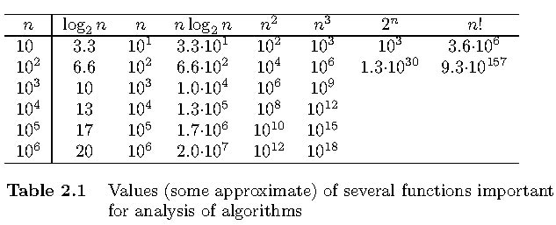
Values of some important functions as n → ∞

Slide 12
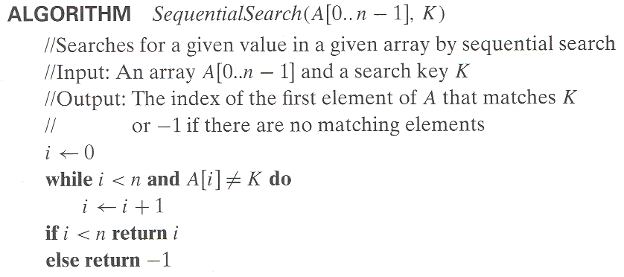
Example: Sequential search
Worst case: n key comparisons
when there are no matching elements or the first matching element happens to be the last one on the list
Best case: 1 comparisons
When the list of size n with its first element equals to a search key
Average case:
K is in A => (n+1)/2 key comparisons
K is not in A => n key comparisons

Slide 13
Best-case, average-case, worst-case
For some algorithms, efficiency depends on form of input:
Worst case: C_{worst}(n) – maximum over inputs of size n
The worst-case efficiency of an algorithm is its efficiency for the worst-case input of size n, which is an input (or inputs) of size n for which the algorithm runs the longest among all possible inputs of that size.
Best case: C_{best}(n) – minimum over inputs of size n
The best-case efficiency of an algorithm is its efficiency for the best-case input of size n, which is an input (or inputs) of size n for which the algorithm runs the fastest among all possible inputs of that size.
Average case: C_{avg}(n) – “average” over inputs of size n
Number of times the basic operation will be executed on typical input
NOT the average of worst and best case

Slide 14
Calculating The Running Time of a program (simple Assignment Statement)
Suppose we have the following segment of a program:
A simple assignment statement to an integer variable.
a=b
Since the assignment statement takes constant time, so its complexity is O(1).

Slide 15
Calculating The Running Time of a program (simple for loop)
Consider a simple for loop
The cost of the entire code fragment (complexity) is

Slide 16
Calculating The Running Time of a program (Several for loops)
Consider a code fragment with several for loops, some of which are nested
The total cost is

Slide 17
Calculating The Running Time of a program (Several for loops)
Compare the asymptotic analysis for the following two code fragments:
Thus, both double loops cost
Although the 2nd requires about ½ the time of the 1st.

Slide 18
NOTE
Not all the doubly nested loops are

Slide 19
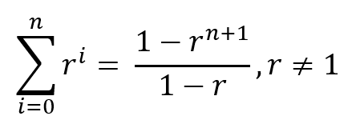
Summation formulas and rules useful in analysis of algorithms

Slide 20
General Plan for Analyzing the Time Efficiency of Nonrecursive Algorithms
Decide on a parameter (or parameters) indicating an input’s size.
Identify the algorithm’s basic operation. (As a rule, it is located in the innermost loop.)
Check whether the number of times the basic operation is executed depends only on the size of an input. If it also depends on some additional property, the worst-case, average-case, and, if necessary, best-case efficiencies have to be investigated separately.
Set up a sum expressing the number of times the algorithm’s basic operation is executed.
Using standard formulas and rules of sum manipulation, either find a closed form formula for the count or, at the very least, establish its order of growth.

Slide 21
Example 1
Thus the time is

Slide 22
See Tutorial # 1
Non-Recursive Examples: Time Complexity

Slide 23
Mathematical Analysis of Recursive Algorithms
Determining the execution time of a recursive subroutine can be particularly difficult.
The running time for a recursive subroutine is typically best expressed by recurrence relation.

Slide 24
General Plan for Analyzing the Time Efficiency of Recursive Algorithms
Decide on a parameter (or parameters) indicating an input’s size.
Identify the algorithm’s basic operation.
Check whether the number of times the basic operation is executed can vary on different inputs of the same size; if it can, the worst-case, average-case, and best-case efficiencies must be investigated separately.
Set up a recurrence relation, with an appropriate initial condition, for the number of times the basic operation is executed.
Solve the recurrence or, at least, ascertain the order of growth of its solution

Slide 25
Example 1: Factorial
For simplicity, we consider n itself as an indicator of this algorithm’s input size (rather than the number of bits in its binary expansion)
The basic operation of the algorithm is multiplication, whose number of executions we denote M(n).
we use what can be called the method of backward substitutions
Take advantage of the initial condition given. Since it is specified for n = 0, we have to substitute i = n in the pattern’s formula to get the ultimate result of our backward substitutions

Slide 26
See Tutorial # 2
Mathematical Analysis of Recursive Algorithms

Slide 27
Empirical analysis of time efficiency

Slide 28
Empirical analysis of time efficiency
Select a specific (typical) sample of inputs
Use physical unit of time (e.g., milliseconds)
or
Count actual number of basic operation’s executions
Analyze the empirical data

